Slide 1
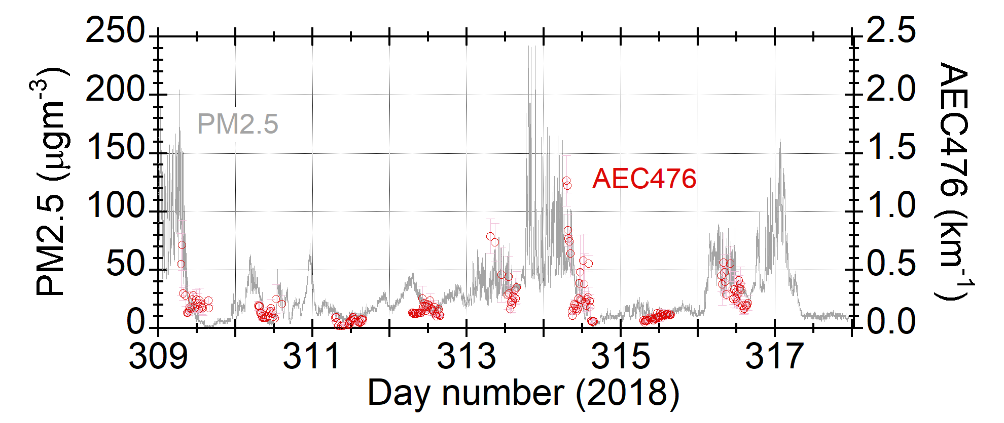
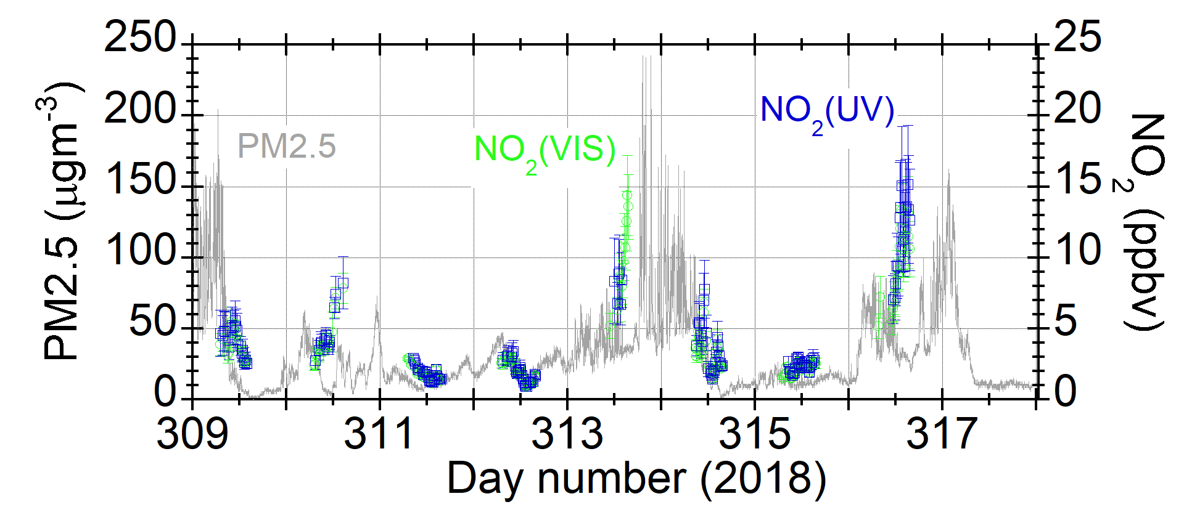
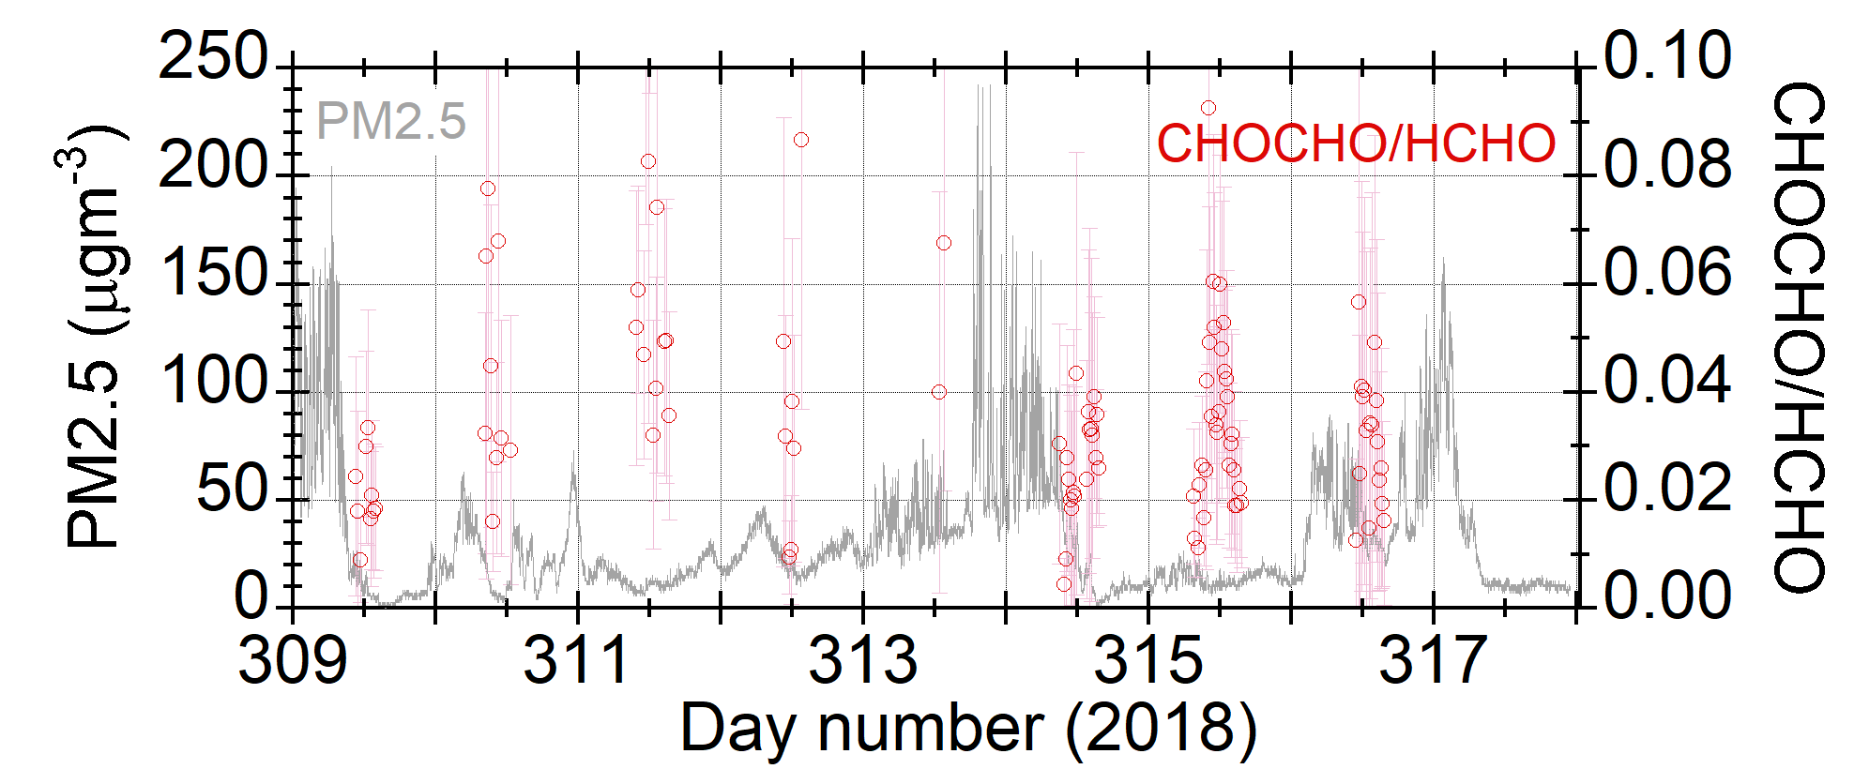
Comparison between PM2.5 and MAX-DOAS data
Nov. 5
Nov. 12
AEC = Aerosol Extinction Coefficient at 476 nm

